Slide 1


High Performance Cluster Computing
Architectures and Systems
Hai Jin
Internet and Cluster Computing Center

Slide 2
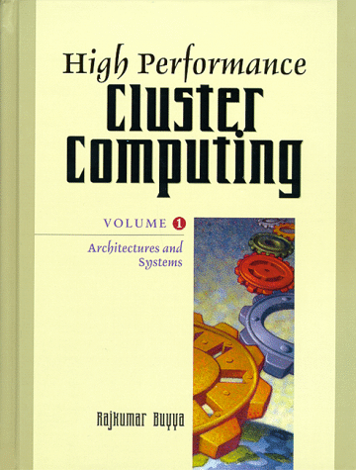
Job and Resource Management Systems
Motivation and Historical Systems
Components and Architecture of Job- and Resource Management
The State-of-the-Art in RMS
Challenges for the Present and the Future
Summary

Slide 3
Motivation and Historical Evolution
A Need for Job Management
  Operating system offers job and resource management service for a single computer
  The batch job control on multi-user mainframes was performed outside the operating system
  Main advantages are
    Allow for a structured resource utilization planning and control by the administration
    Offer the resources of a compute center to a user in an abstract, transparent, easy-to-understand and easy-to-use fashion
    Provide a vendor independent user interface
  The first RMS of this type was NQS (Network Queuing System)

Slide 4
Job Management Systems on Workstation Clusters
Using workstation clusters imposes specific requirements on job management systems
A typical job management system usually offers
  Heterogeneous Support
  Batch Support
  Parallel Support
  Interactive Support
  Check-pointing and Process Migration
  Load Balancing
  Job Run-Time Limits
  GUI
Primary application field
  Checkpointing and migrating jobs
  Parallel programs or I/O intensive jobs

Slide 5
Components and Architecture of Job and Resource Management Systems (I)
Prerequisites
  Basic prerequisites
    The computers are interconnected by a network
    The computers provide multi-user as well as multi-tasking capabilities
  Homogeneous operating system architectures are not a restriction
  In practice, the following situation occurs frequently
    “Similar” operating systems run on all machines
    UNIX (in all variants) is very customary in the context of using RMS
    Microsoft’s Windows NT introduced the interest in the usage of relatively cheap PC hardware for clustered batch processing

Slide 6
Components and Architecture of Job and Resource Management Systems (II)
User interface
  RMS at least provides a command line user interface
  Typical commands
    A job submission command to register jobs for execution with the RMS
    A status display command to monitor progress or failure of a job
    A job deletion command to cancel jobs no longer needed
  Some of the popular RMS also offer a GUI

Slide 7
Components and Architecture of Job and Resource Management Systems (III)
Administrative environment
  Specify machine characteristics for the hosts in the RMS pool
  Define feasible job classes and the appropriate hosts for the job classes
  Define user access permissions
  Specify resource limitations for users and jobs
  Specify policies for the assignment of jobs according to load or other site specific preferences
  Control and ensure proper operation of the RMS
  Analyze accounting data to tune the system
A command line interface needs to be available
An administrative GUI is offered in some RMS

Slide 8
Managed Objects: Queues
The concept of queues refers to the standard computer science first-in-first-out queue
Mechanism
  A job is assigned to a queue and processed on a host bound to the queue
  If all queues are busy with a job when a new job is submitted, the new job waits until a queue becomes available

Slide 9
Managed Objects: Hosts
Server nodes
  Compute services: consists of executing jobs
  RMS management services: covers all types of tasks to guarantee the operability of the RMS (network communication, scheduling, RMS configuration, etc.)
Submit/control hosts
  To pass jobs to the RMS for execution and to control jobs respectively

Slide 10
Managed Objects: Jobs
A job in the context of a RMS is any agglomeration of computational tasks usually solving a complex problem
A job
  May consist of a single program, of several interacting programs
  May also utilize operating system commands
There are four types of jobs in the context of RMS
  Batch Jobs: require no manual interaction as soon as started
  Interactive Jobs: require input during runtime
  Parallel Jobs: subtasks spread across several hosts in a cluster
  Check-pointing Jobs: periodically save status to the file system and can be aborted anytime

Slide 11
Managed Objects: Resources
The term resources
  Often called attributes
  Refers to the available memory, CPU time, and peripheral devices
A job is accompanied by its resource requirements
An RMS should ensure that resources are not oversubscribed by running jobs
  This can be performed by comparing resource utilization information with the thresholds defined by the cluster administration

Slide 12
Managed Objects: Policies
To manage the computational resources of a cluster, categorizing classes of jobs in terms of queues is used
A RMS may offer more abstract and advanced mechanisms to automate control of utilization of a compute server environment
Two types of policies
  Resource Utilization Policies
  Scheduling Policies

Slide 13
Resource Utilization Policies (I)
Share based
  Resource utilization entitlements with respect to the whole cluster are assigned to organization entities such as users, departments or projects
  Advanced RMS allow the definition of resource shares by means of a hierarchical share tree
  An attribute of share based utilization policies is that they attempt to establish the defined resource entitlements within a time window
Functional
  Like share based policies, they also define resource entitlement
  Past usage is not taken into account in functional policies
  The resource entitlements maintained as fixed level of importance

Slide 14
Resource Utilization Policies (II)
Deadline
  Time critical applications which are required to finish before a given dead-line represent a problem
Manual override
  An administrator may raise the resource entitlement of a certain job or of all jobs of a user, department, project and job class by a certain and well-interpretable quantity

Slide 15
Scheduling Policies
Apply only to the process of dispatching jobs
A RMS may provide a variety of scheduling policies
  First-Come-First-Served
  Select-Least-Loaded
  Select-Fixed-Sequence
  Combinations above

Slide 16
A Modern Architectural Approach
A structured design is vital for the quality of service that a RMS provides
The central CODINE/GRD functionality is provided by three types of daemons
  cod_qmaster: master daemon
  cod_schedd: scheduler is implemented in cod_schedd
  cod_execd: execution daemon
The three daemons communicate over a communication system based upon TCP and provided by the CODINE/GRD communication daemon cod_commd

Slide 17
Automated Policy Based Resource Management (I)
Requirements and Goals
  Goal
    Maximally achieve the performance goals of the enterprise
    This is accomplished through resource management polices
  Weaknesses in mediating the sharing of resources
    Applications will rarely perform at the optimum performance because imbalanced load is the common situation in multiprocessing environments
    Important/urgent work may be deferred or starved for resources while other work is initiated and processed
    Unauthorized users may inadvertently dominate shared resources by simply submitting the largest amount of work
    A user may grossly exceed her/his desired resource utilization level over time
  Requirement
    Dynamic reallocation of resources is a prerequisite to optimal workload management

Slide 18
Automated Policy Based Resource Management (II)
Quantifying Availability and Usage of Resources
  GRD performs resource tasking based upon the utilization and collective capabilities of an entire system of resources
    In order to avoid improper dispatching of jobs
  GRD continuously maintains alignment of resource utilization with policies, using a dynamic workload regulation scheme
  GRD monitors and adjusts resource usage correlated to all processes of a job

Slide 19
Automated Policy Based Resource Management (III)
Policy Models
  Shared based
    Supports hierarchical allocation of resources
  Functional
    Supports relative weighting among users, projects, departments, and job classes during execution
  Initiation deadline
    Automatically escalates a job’s resource entitlement over time as it approaches its deadline
  Override
    Adjusts resource entitlements at the job, job class, user, project, or department levels

Slide 20
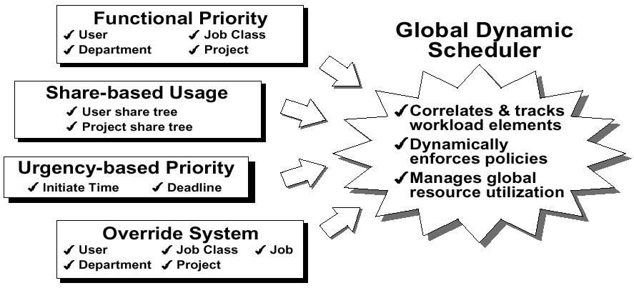
GRD Policy Integration

Slide 21
Automated Policy Based Resource Management (IV)
Policy Enforcement
  GRD is implemented by a dynamic scheduling facility
  Multiple feed-back loops to adjust CPU shares of concurrently executing jobs toward dynamically changing requirements

Slide 22
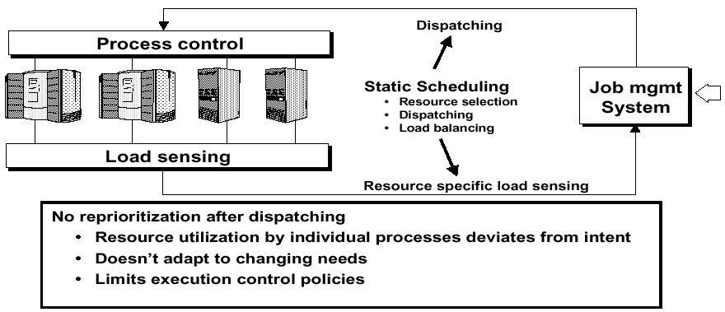
Static Scheduling Scheme

Slide 23
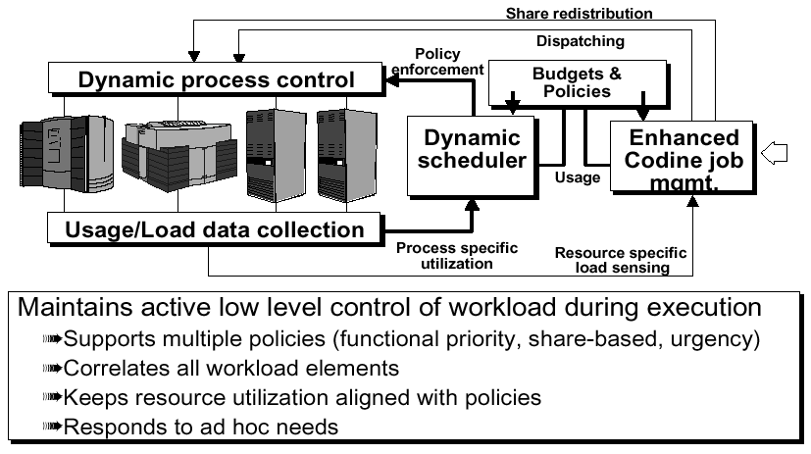
GRD’s Dynamic Scheduling Scheme

Slide 24
The State-of-the-Art of Job Support (I)
Serial Batch Jobs
  All RMS allow to submit batch jobs
  The ability to suspend and resume execution of batch jobs and to restart batch jobs after system crashes is a standard today
Interactive Support
  Interactive job need to maintain a terminal connection
  When the interactive user suffers from background RMS jobs, “watchdog” program withdraw such machines from the RMS pool subsequently

Slide 25
The State-of-the-Art of Job Support (II)
Parallel Support
  Not all RMS provide parallel support
  The kind of support provided differs considerably
Support of Arbitrary or Particular PPEs
  Fixed integrated parallel support (e.g.. Condor) providing an interfaces to PVM only
  CODINE/GRD offers freely configurable start-and-stop procedures for each PPE to be supported

Slide 26
The State-of-the-Art of Job Support (III)
Level of Control for Parallel Processes
  A simple way to provide an interface between a RMS and PPEs consists of submitting a start-up procedure/script for the run-time environment of PPEs to the RMS instead of a simple job script
  An approach proposed by the psched initiative
    APIs linking a RMS and PPEs to exchange information

Slide 27
The State-of-the-Art of Job Support (IV)
Mechanisms for dealing with the checkpointing of a job are provided
  LSF and CODINE/GRD provide interfaces for so-called kernel level, application level and library based checkpointing
  LoadLeveler and Condor provide checkpointing only for applications linked with operating specific libraries enabling the facility

Slide 28
Challenges for the Present and the Future (I)
Open Interfaces
  Advanced APIs are needed
    Developers might want to use a RMS’s load balancing and load distribution capabilities to distribute computational subtasks across a network of compute hosts
    For various reasons it is necessary to retrieve the following kind of information from inside RMS related applications
      The overall load situation
      The status of jobs
      The status of queues
    A software developer might want to pass information to a RMS system to support the scheduler
    Especially for the purpose of low-level integration of RMS with other software systems
    An RMS’s graphical user’s and administrator’s interface should use API to configure RMS objects or to submit and monitor batch requests
    RMS administrators might wish to write special-purpose RMS commands in case the site’s users expect a very special behavior

Slide 29
Challenges for the Present and the Future (II)
Open Interfaces
  Advance RMS API must satisfy following requests
    API must be easy to use
    API need to be usable from any programming language
    API must hide RMS implementation details from the application developer
    Internal RMS changes should not necessarily require software built upon the API to be changed
  CODINE/GRD API already meets these requirements
    is a applicable for any client/server in CODINE/GRD
    is extensible without requiring recompilation for every API-based program
    has a SQL inspired interface

Slide 30
Challenges for the Present and the Future (III)
Resource Control and Mainframe-Like Batch Processing
  RMS controls the following resources
    Compute cycles
    Main memory
    Disk space
    Peripheral devices such as printer, tape drives
    Different operating system and hardware architectures
    Licenses for the installed base and application software
    Network interconnect and its bandwidth

Slide 31
Challenges for the Present and the Future (IV)
Heterogeneous Parallel Environments
  Shared Memory Parallel Machines
    Processor affinity is one of the common requirements that are demanded by users of shared memory parallel machines
  Dedicated Distributed Memory Parallel Machines
    The problem is that there are several types of machines available from several vendors showing strongly different characteristics
  Cluster Based Distributed Memory Parallel Machines
    Using clusters as distributed memory parallel machines brings in several complications
    The most important are difficulties in interfacing parallel programming environments
    Problems caused by the multi-user and multitasking nature of cluster computers

Slide 32
Challenges for the Present and the Future (V)
RMS in a WAN Environment
  Many large industrial and research organizations operate with several branches being separated by long distances
  Applying a RMS to a WAN yields a number of problems related to
    Security
    Remote file access
    Accounting
    Network bandwidth

Slide 33
Summary
Today’s RMS offer good utilization of compute resources for a wide variety of applications
They have proven their usefulness in production environments and still extend their application area
Need to evolve and integrate with other client/server software
CODINE/GRD is well recognized as one of the leading RMS for clusters today and is well-equipped for the challenges of the future

